Slide 1
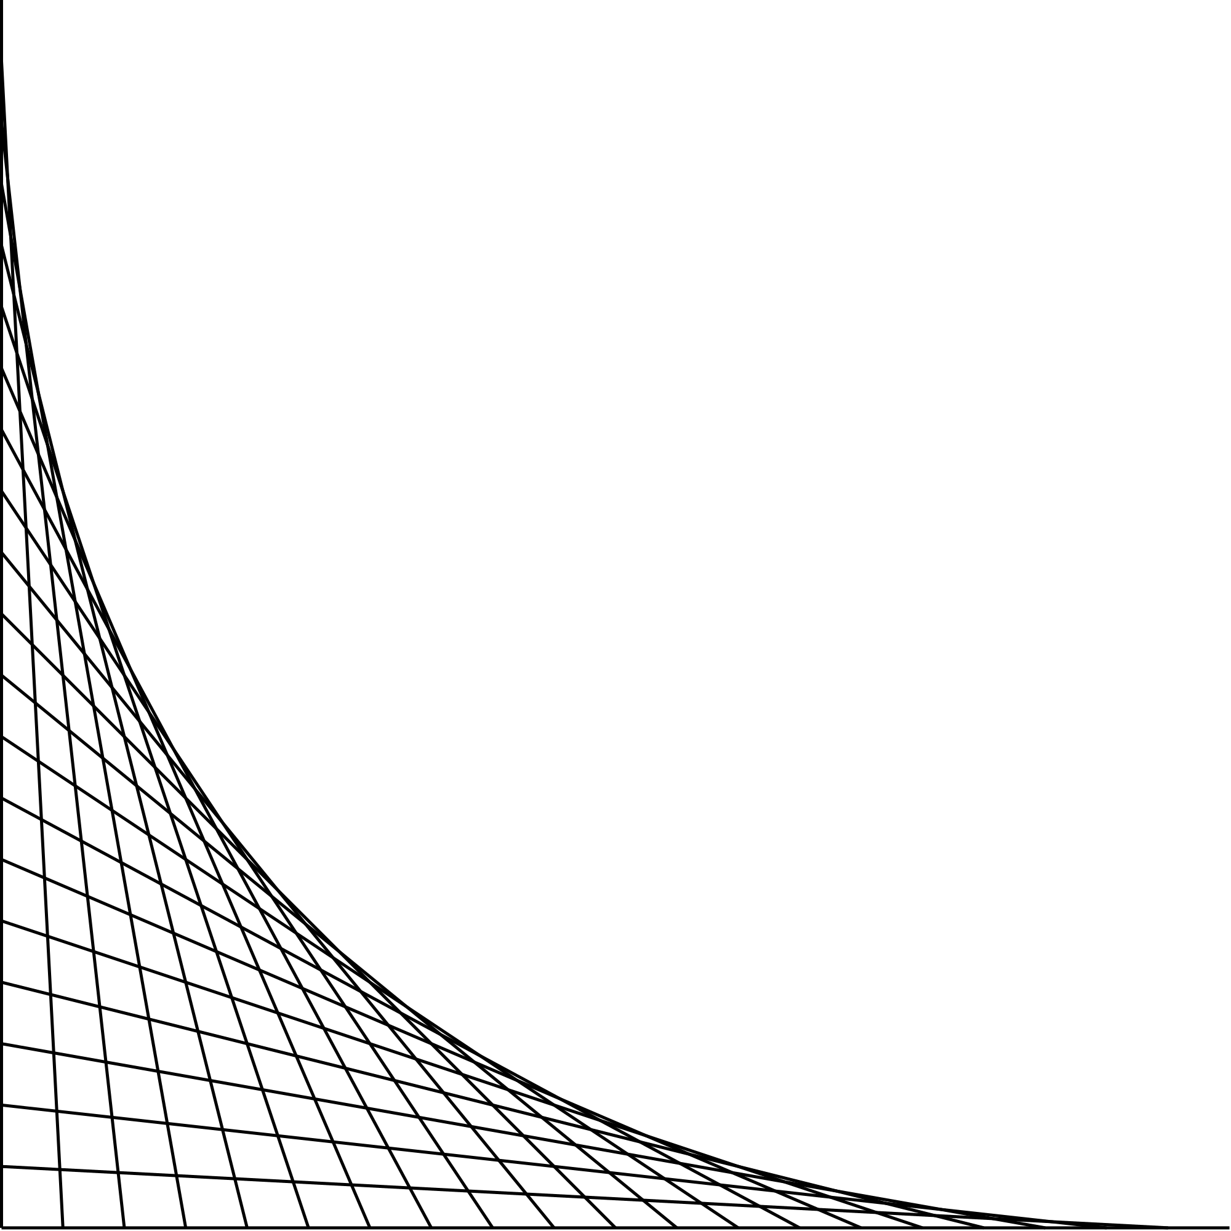
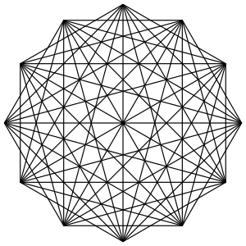
OOP3D
Application User Manual
By Paola Jiron

Slide 2
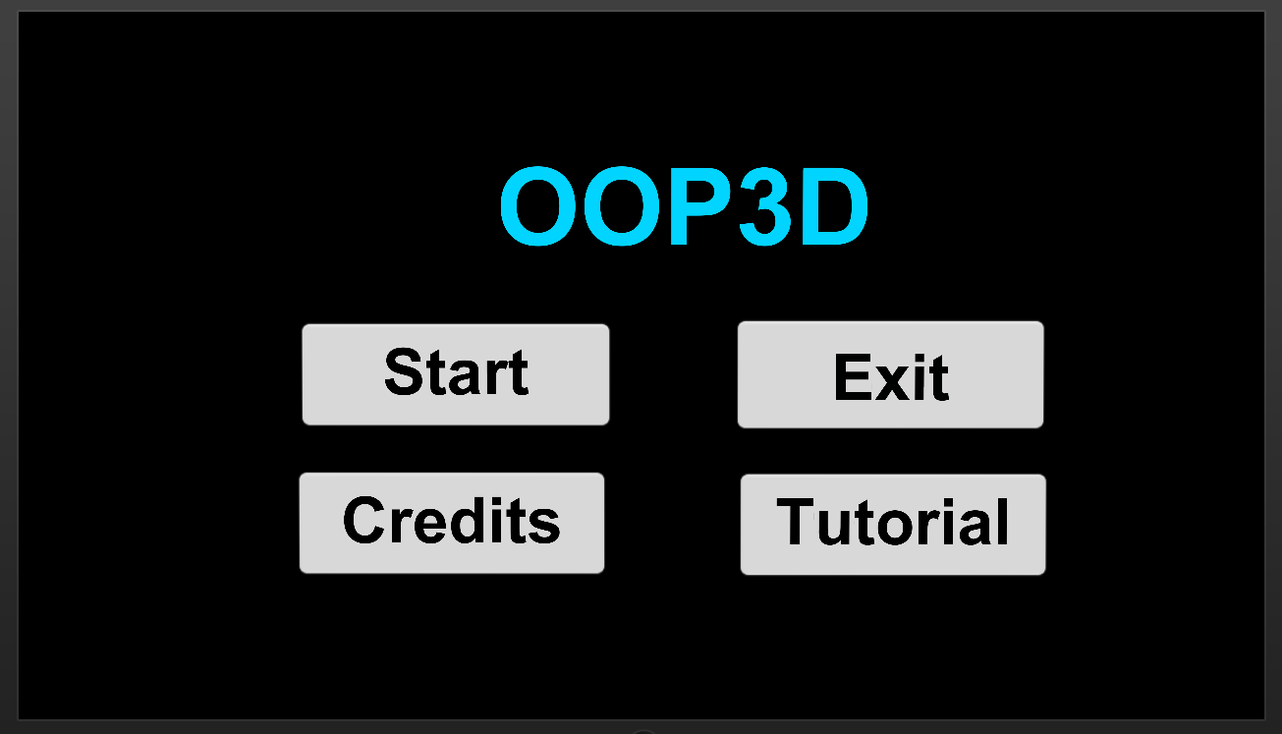
Menu Scene
The Start button follows three scenes: Variables, Methods, and Data Structures scenes respectively which include a question and four objects, that are the optional responses to that question.
The Exit button terminates the application.
The Credits button displays the contact information of the developer and contributors of the app
The Tutorials button follows six scenes with thorough tutorials on: Variables, Methods, Arrays, Stacks, Queues, and Linked Lists respectively. Each tutorial scene contains a NEXT button leading to the following tutorial. Every tutorial has the following information: facts and concepts, syntax, code examples, and editorials.

Slide 3
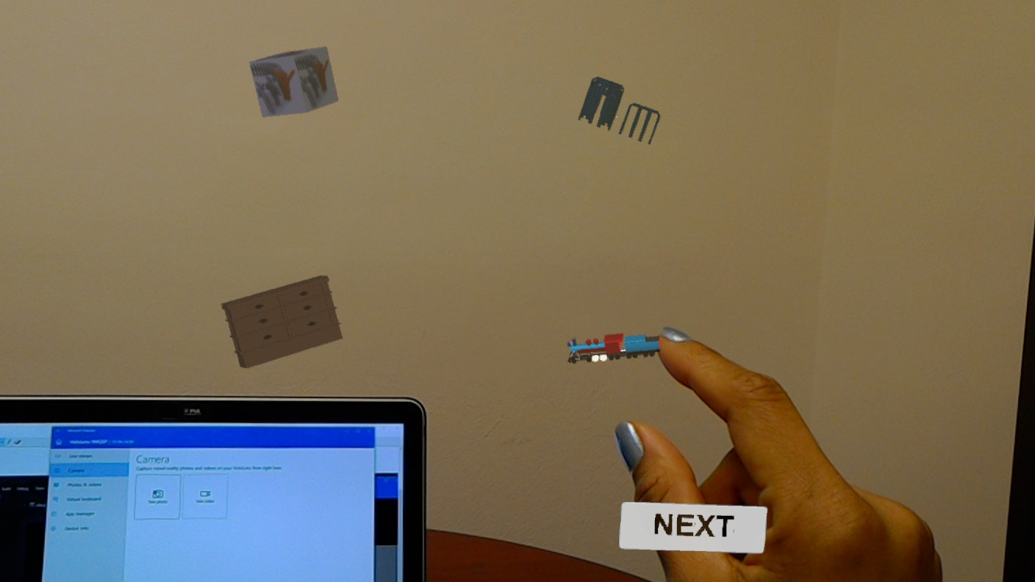
Interaction
Gaze: Hololens uses the position and orientation of your user's head, not their eyes, to determine their gaze vector. Gaze Input in Hololens indicate where the user is currently focusing on.
Gesture: For Hololens, gesture input lets you interact with your holograms naturally by finger tapping.

Slide 4
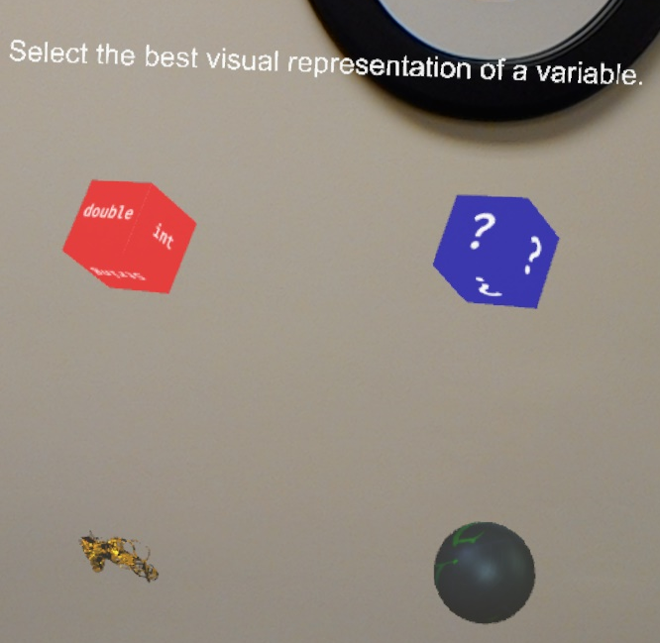
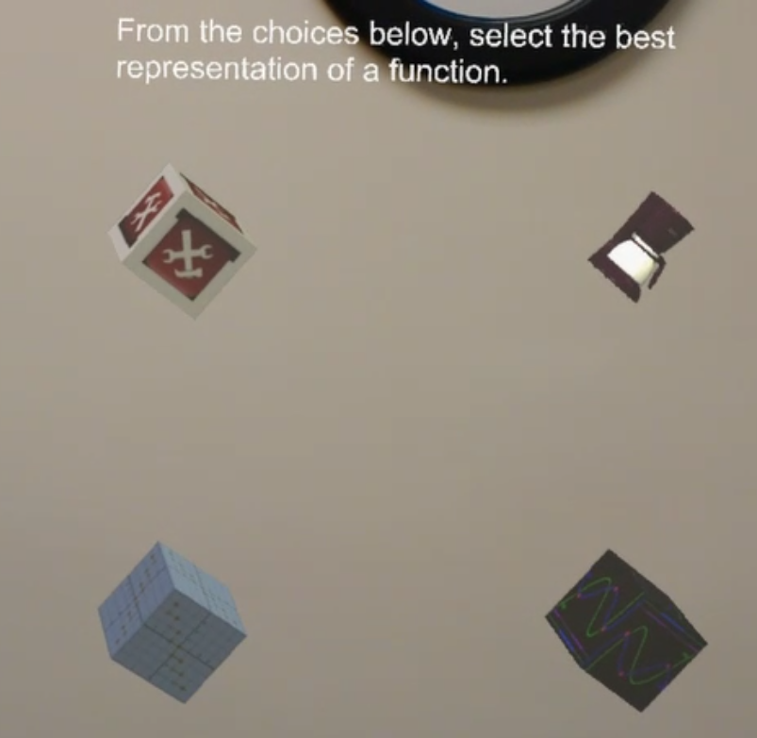
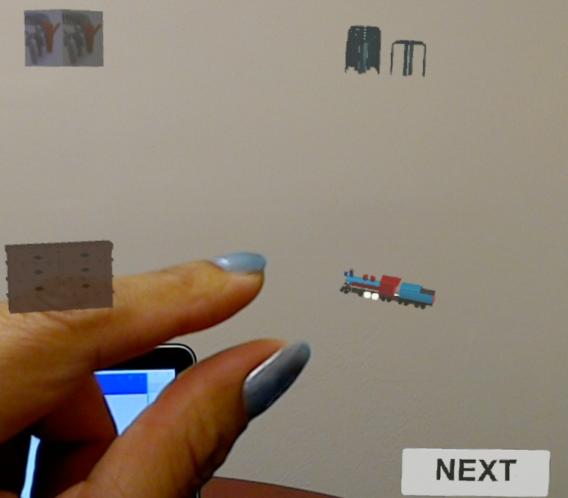
Game Scenes
Variables
Methods
There are 3 scenes in the game:
Variables,
Methods, and
Data Structures
The scenes include a question and four optional responses
After each response, the user has the choice to either answer, or move to the next scene without responding. This is done by clicking the NEXT button at the bottom right corner of each scene.
Data Structures

Slide 5
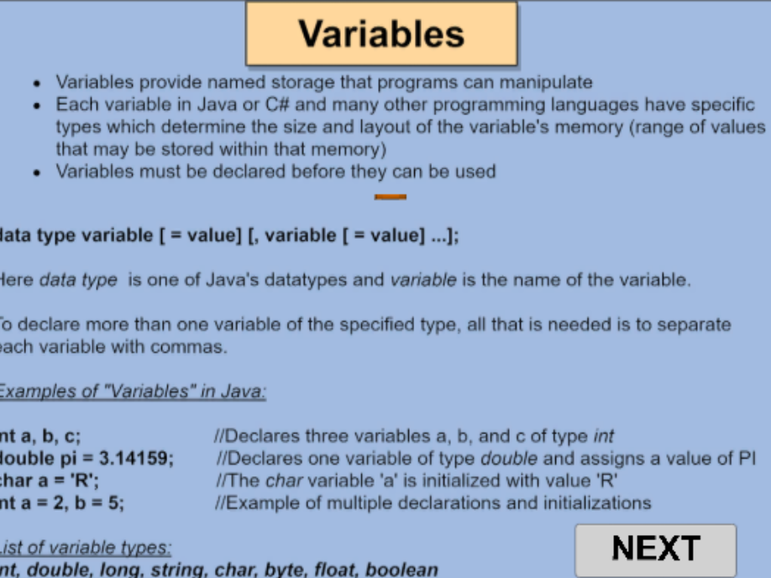
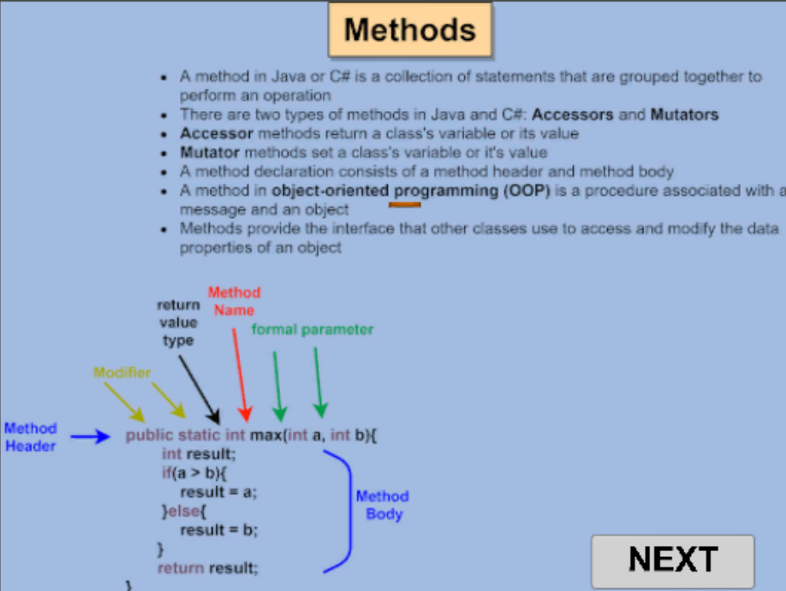
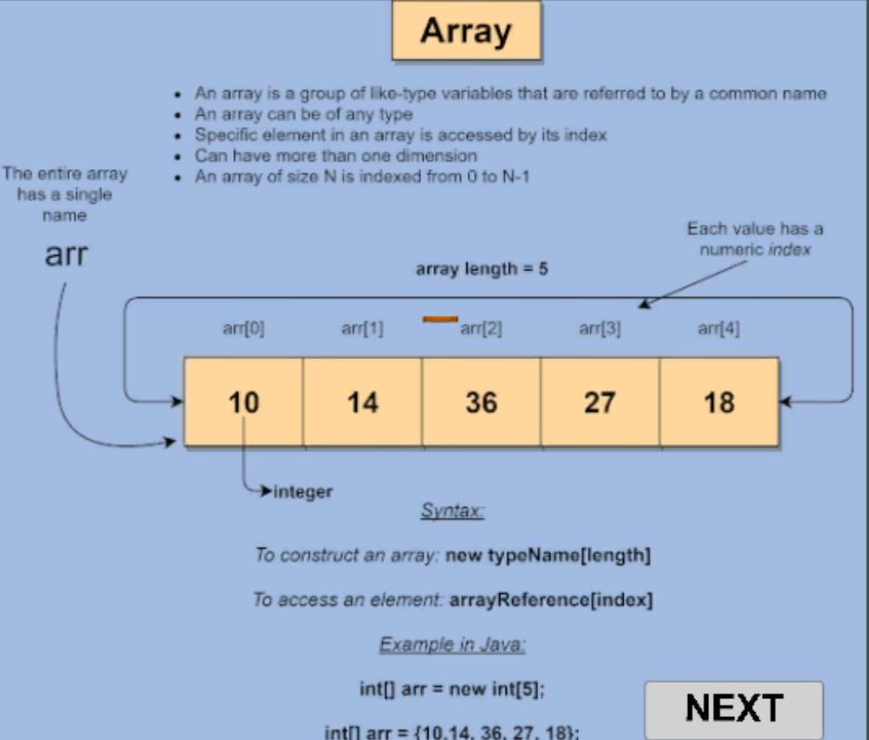
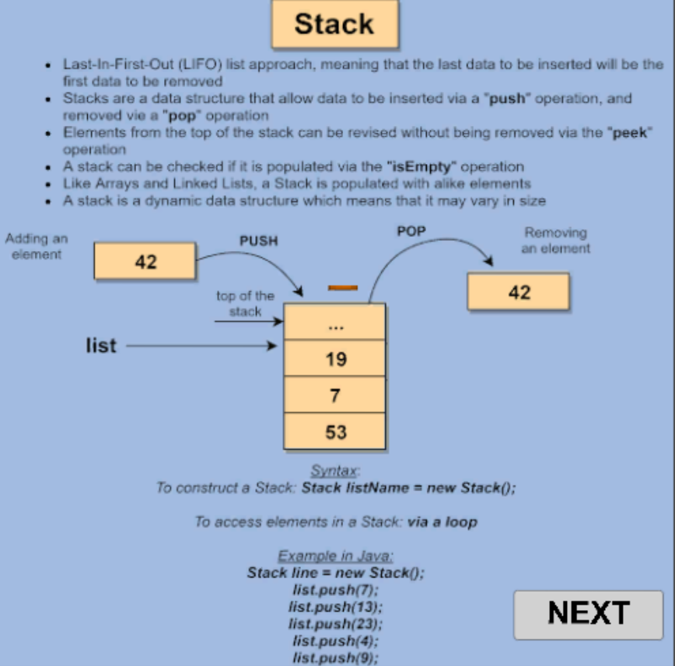
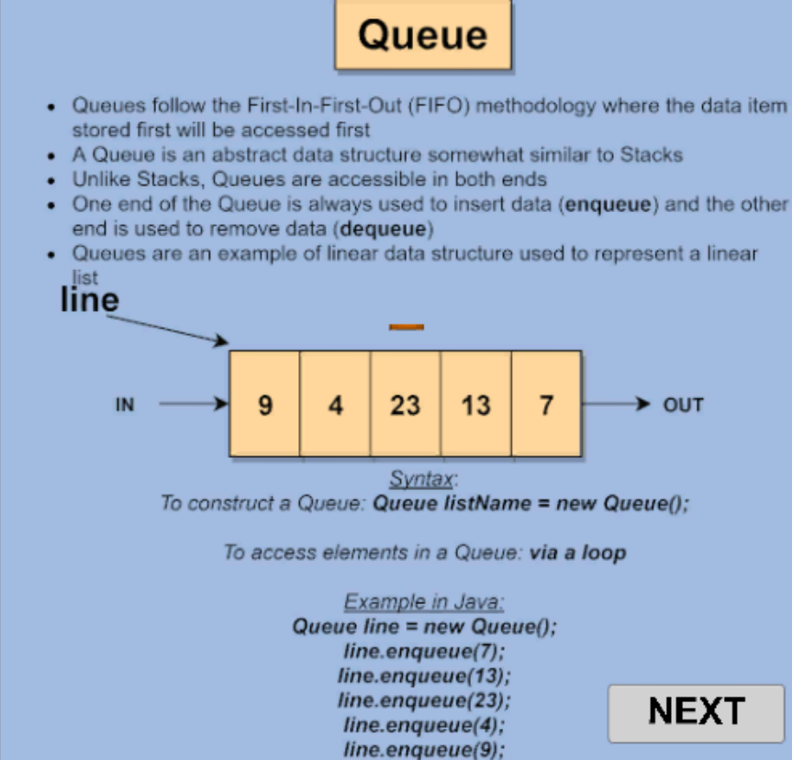

Tutorials Scenes
Variables
Methods
Arrays
There are 6 tutorials scenes:
Variables,
Methods,
Arrays,
Stacks,
Queues,
and Linked Lists
Each tutorial scene contains a NEXT button leading to the following tutorial.
Every tutorial has the following information: facts and concepts, syntax, code examples, and editorials.
Stacks
Queues
Linked Lists

Slide 6
Requirements
Hololens device
Hololens Clicker (optional)

